Slide 1

Vehicle Insurance Fraud Detection
This Photo by Unknown Author is licensed under CC BY-ND

Slide 2

Background and Context
Vehicle insurance fraud is a pervasive issue involving fabricated or exaggerated claims, including staged accidents, phantom passengers, and false injury reports.
The Vehicle Insurance Fraud Detection project aims to utilize a diverse set of features to predict the likelihood of fraudulent claims, streamlining the detection process for insurers. By leveraging advanced data analysis techniques and machine learning algorithms, the project seeks to automate the identification of suspicious activity, ultimately reducing financial losses and ensuring fair premiums for policyholders.

Slide 3

Objectives
The objective behind this project is to protect insurance companies from financial losses that can result from fraudulent activities.
The goal of this project is to use the collection of features and Machine Learning Algorithms to predict whether a claim is fraudulent.

Slide 4
Methods: Models to be Implemented
Selected Models
Classification models are ideal for predicting outcomes that fall into multiple categories. Given that the target variable in this case is binary (fraud or not fraud), we opted to concentrate on two commonly used classification algorithms.
Logistic Regression
Logistic Regression is a supervised learning method designed for binary classification scenarios, where the outcome falls into two categories. Utilizing the sigmoid function, it computes the probability of an event y given specific features x. This probability is expressed as P(y) = 1 / (1 + exp(-x)), encapsulating the chance of the event's occurrence based on the provided features.
K Nearest Neighbors (KNN)
K-Nearest Neighbors (KNN) operates by leveraging similar features to predict the values of new data points. This approach entails assigning a value to a new data point based on its similarity to existing data points within the training set. In essence, KNN determines the classification of a data point by examining the characteristics of its nearest neighbors in the feature space.

Slide 5
Methods: Model Evaluation Criteria
Model evaluation criterion
The model can make two types of wrong predictions:
Predicting a claim was a fraud when the claim wasn’t a fraud.
Predicting a claim was not a fraud and the claim was actually a fraud.
Which case is more important?
Predicting a claim was not a fraud and the claim was actually a fraud, This scenario represents a false negative, where the model fails to detect fraudulent activity, potentially resulting in financial losses for the insurance company. Identifying fraudulent claims accurately is paramount for minimizing losses and maintaining the integrity of the insurance system. Therefore, ensuring the model's ability to detect fraud with high sensitivity is crucial for effective fraud prevention.
How to reduce this loss i.e the need to reduce False Negatives?
The company's priority lies in maximizing Recall to minimize false negatives, as a higher Recall increases the likelihood of accurately identifying true positives (Class 1). By focusing on enhancing Recall and effectively identifying fraudulent claims, the company can develop new rules and measures to control fraud, bolstering its overall fraud detection efforts.

Slide 6
Exploratory Data Analysis - Notable Results
1. The highest number of fraudulent claims are made in March and the day is Monday.
2. Urban Areas have seen 89% claims and 85% of Fraud claims.
3. Most of the Fraudulent cases are from Male holders and most of the time the fault is of the policy Holder.
4. One of the best predictor to use in here will be Witness and Police Report as 95% of Fraud cases does not have an Witness and no report is filed at the police.
5. 1994 constitutes about 44% of Fraud Cases.
6. Almost 99% of Fraud Cases have an external Agent.

Slide 7
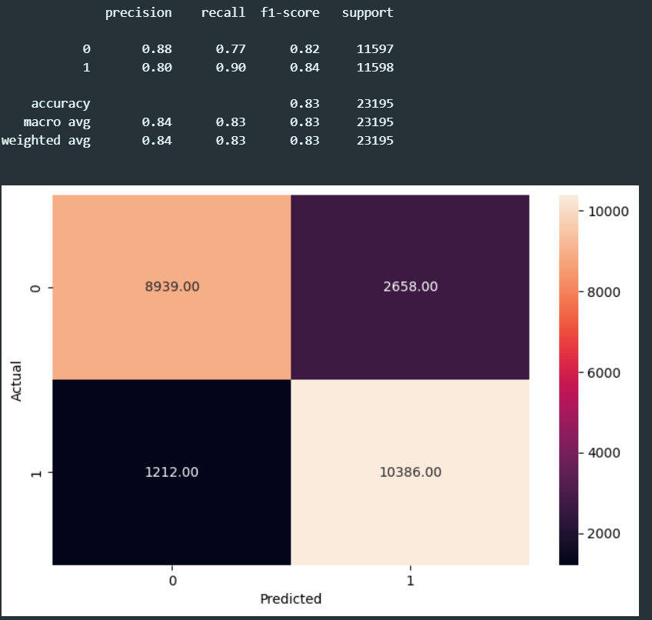
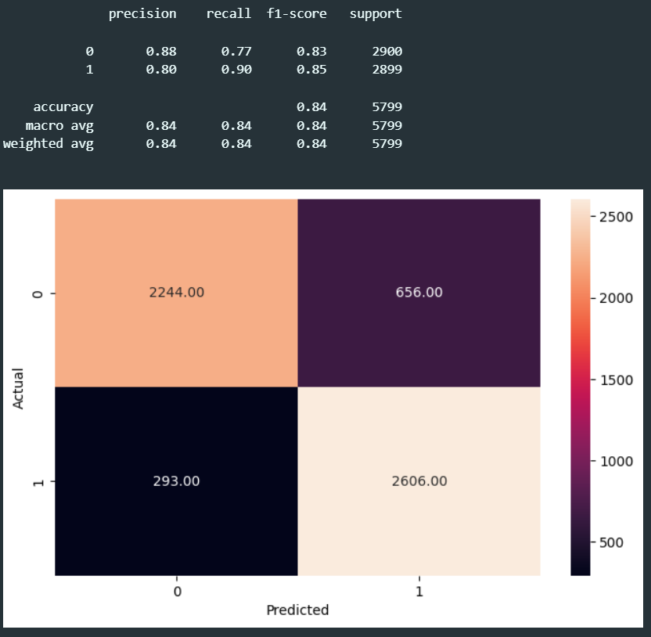
Results - Logistic Regression
The model demonstrates consistent performance across both the training and test datasets, suggesting that it will likely generalize effectively. With an accuracy hovering around 83% on the training set and 84% on the test set, the model showcases robustness in its predictive capabilities. Moreover, achieving a recall rate of 90% for class 1 on both the training and test datasets

Slide 8
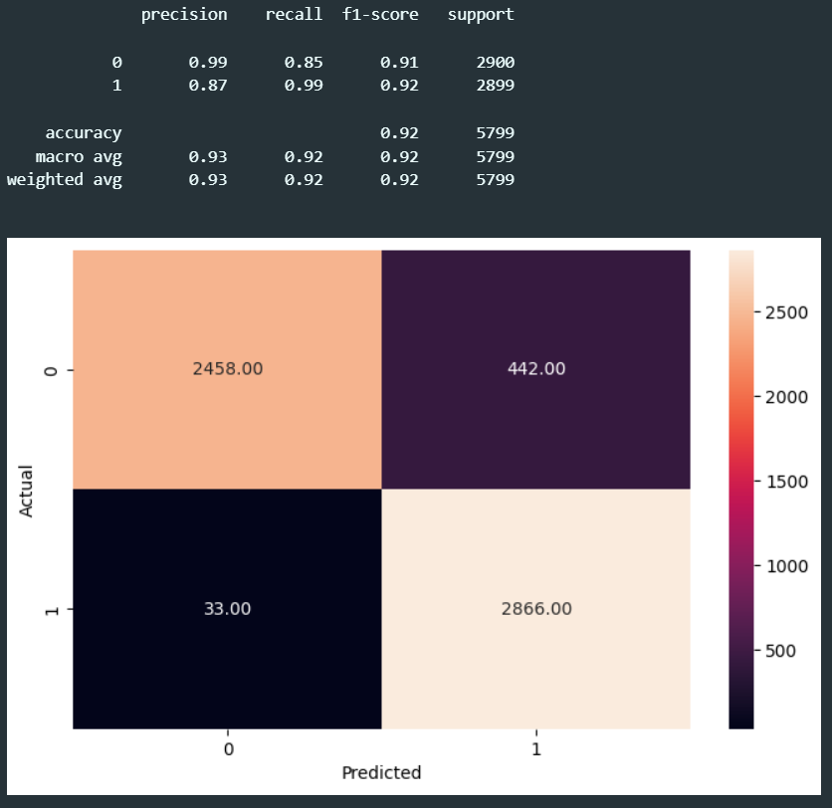
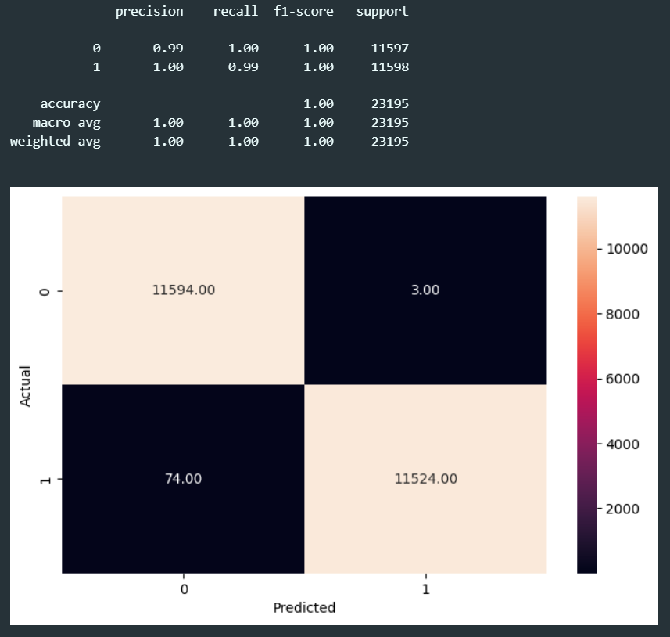
Results – KNN with 2 Neighbors and after handling unbalanced data using SMOTE
This high-performing model presents a valuable tool for the company in identifying fraudulent claims. Despite potential overfitting, indicated by better performance on training data than on testing data, the model boasts a remarkable 99% likelihood of detecting potentially fraudulent claims.
With such confidence in its predictive capabilities, the company can take swift and appropriate action to address suspicious claims, bolstering its fraud detection efforts effectively.

